Slide 1
Software Design
Static Modeling using the
Unified Modeling Language (UML)
Material based on
[Booch99, Rambaugh99, Jacobson99, Fowler97, Brown99]
Software Design (UML)

Slide 2
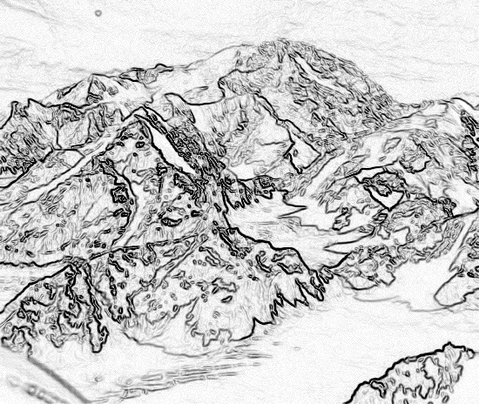
Chapter 2,
Modeling with UML

Slide 3
Overview: modeling with UML
What is modeling?
What is UML?
Use case diagrams
Class diagrams
Sequence diagrams
Activity diagrams

Slide 4
What is modeling?
Modeling consists of building an abstraction of reality.
Abstractions are simplifications because:
  They ignore irrelevant details and
  They only represent the relevant details.
What is relevant or irrelevant depends on the purpose of the model.

Slide 5
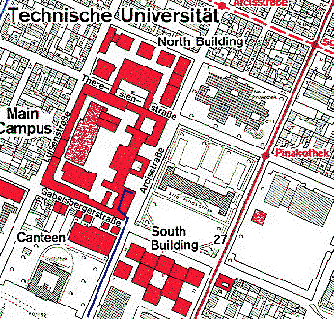
Example: street map

Slide 6
Why model software?
Why model software?
Software is getting increasingly more complex
  Windows XP > 40 million lines of code
  A single programmer cannot manage this amount of code in its entirety.
Code is not easily understandable by developers who did not write it
We need simpler representations for complex systems
  Modeling is a mean for dealing with complexity

Slide 7
What is UML?
UML (Unified Modeling Language)
  An emerging standard for modeling object-oriented software.
  Resulted from the convergence of notations from three leading object-oriented methods:
    OMT (James Rumbaugh) Object Modeling Technique
    OOSE (Ivar Jacobson) Object Oriented Software Engineering
    Booch (Grady Booch)
Reference: “The Unified Modeling Language User Guide”, Addison Wesley, 1999.
Supported by several CASE tools
  Rational ROSE
  TogetherJ

Slide 8
UML: First Pass
You can model 80% of most problems by using about 20 % UML
We teach you those 20%

Slide 9
UML First Pass
Use case Diagrams
  Describe the functional behavior of the system as seen by the user.
Class diagrams
  Describe the static structure of the system: Objects, Attributes, Associations
Sequence diagrams
  Describe the dynamic behavior between actors and the system and between objects of the system
Statechart diagrams
  Describe the dynamic behavior of an individual object (essentially a finite state automaton)
Activity Diagrams
  Model the dynamic behavior of a system, in particular the workflow (essentially a flowchart)

Slide 10
UML first pass: Use case diagrams
Package
Use case
Watch
Actor
ReadTime
WatchUser
SetTime
WatchRepairPerson
ChangeBattery
Use case diagrams represent the functionality of the system
from user’s point of view

Slide 11
UML first pass: Class diagrams
Class diagrams represent the structure of the system
Association
Class
Multiplicity
Watch
1
1
1
2
1
1
PushButton
LCDDisplay
Time
now
state
blinkIdx
blinkSeconds()
blinkMinutes()
blinkHours()
stopBlinking()
referesh()
push()
release()
Attribute
Operations

Slide 12
UML first pass: Sequence diagram
Actor
Object
:WatchUser
:Watch
:LCDDisplay
:Time
pressButton1(& 2)
blinkHours()
pressButton1()
blinkMinutes()
Message
pressButton2()
incrementMinutes()
refresh()
pressButtons1And2()
commitNewTime()
stopBlinking()
Activation
Lifeline
Sequence diagrams represent the behavior as interactions

Slide 13
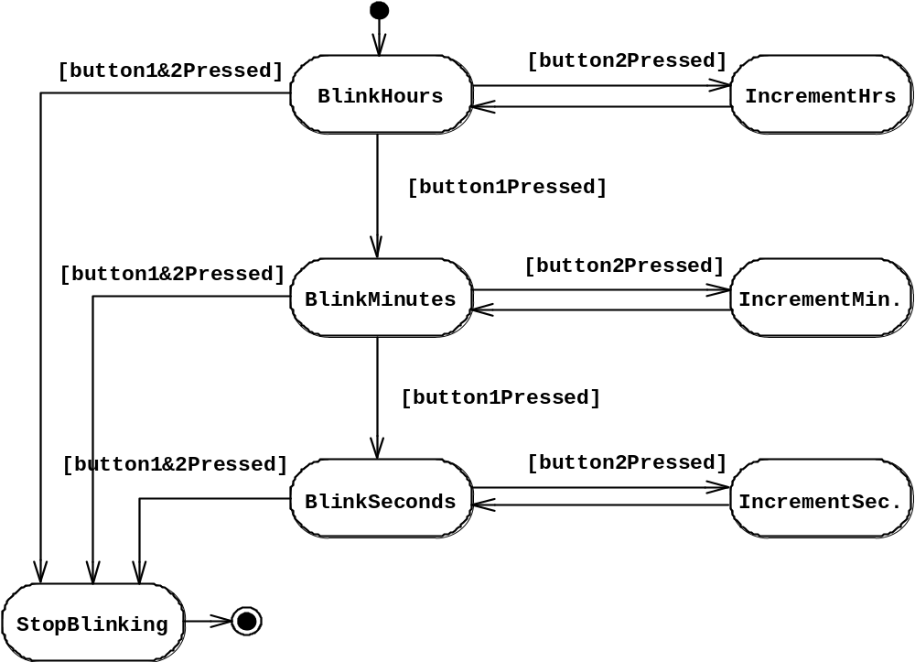
UML first pass: Statechart diagrams for objects with interesting dynamic behavior
State
Event
Initial state
Transition
Final state
Represent behavior as states and transitions

Slide 14
Use Case Diagrams
Used during requirements elicitation to represent external behavior
Actors represent roles, that is, a type of user of the system
Use cases represent a sequence of interaction for a type of functionality
The use case model is the set of all use cases. It is a complete description of the functionality of the system and its environment
Passenger
PurchaseTicket

Slide 15
Actors
An actor models an external entity which communicates with the system:
  User
  External system
  Physical environment
An actor has a unique name and an optional description.
Examples:
  Passenger: A person in the train
  GPS satellite: Provides the system with GPS coordinates
Passenger

Slide 16
Use Case
A use case represents a class of functionality provided by the system as an event flow.
A use case consists of:
Unique name
Participating actors
Entry conditions
Flow of events
Exit conditions
Special requirements
PurchaseTicket

Slide 17
Use Case Diagram: Example
Name: Purchase ticket
Participating actor: Passenger
Entry condition:
Passenger standing in front of ticket distributor.
Passenger has sufficient money to purchase ticket.
Exit condition:
Passenger has ticket.
Event flow:
1. Passenger selects the number of zones to be traveled.
2. _x0008_Distributor displays the amount due.
3. Passenger inserts money, of at least the amount due.
4. Distributor returns change.
5. Distributor issues ticket.
Anything missing?
Exceptional cases!

Slide 18
The <<extends>> Relationship
<<extends>> relationships represent exceptional or seldom invoked cases.
The exceptional event flows are factored out of the main event flow for clarity.
Use cases representing exceptional flows can extend more than one use case.
The direction of a <<extends>> relationship is to the extended use case
Passenger
PurchaseTicket
<<extends>>
<<extends>>
<<extends>>
OutOfOrder
<<extends>>
TimeOut
Cancel
NoChange

Slide 19
The <<includes>> Relationship
<<includes>> relationship represents behavior that is factored out of the use case.
<<includes>> behavior is factored out for reuse, not because it is an exception.
The direction of a <<includes>> relationship is to the using use case (unlike <<extends>> relationships).
Passenger
PurchaseMultiCard
PurchaseSingleTicket
<<includes>>
<<includes>>
<<extends>>
CollectMoney
<<extends>>
NoChange
Cancel

Slide 20
Use Case Diagrams: Summary
Use case diagrams represent external behavior
Use case diagrams are useful as an index into the use cases
Use case descriptions provide meat of model, not the use case diagrams.
All use cases need to be described for the model to be useful.

Slide 21
Class Operations
Class Name
The name of the class is the only required tag in the graphical representation of a class. It always appears in the top-most compartment.
Person
name : String
address : Address
birthdate : Date
ssn : Id
Class Attributes
An attribute is a named property of a class that describes the object being modeled.In the class diagram, attributes appear in the second compartment just below the name-compartment.
eat
sleep
work
play
Class Operations
Operations describe the class behavior
and appear in the third compartment.
Software Design (UML)

Slide 22
Relationships
In UML, object interconnections (logical or physical), are
modeled as relationships.
There are three kinds of relationships in UML:
  dependencies
  generalizations
  associations
Software Design (UML)

Slide 23
Dependency Relationships
A dependency indicates a semantic relationship between two or
more elements. The dependency from CourseSchedule to Course exists because Course is used in both the add and remove operations of CourseSchedule.
CourseSchedule
Course
add(c : Course)
remove(c : Course)
Software Design (UML)

Slide 24
Generalization Relationships
Person
A generalization connects a subclass
to its superclass. It denotes an
inheritance of attributes and behavior
from the superclass to the subclass and
indicates a specialization in the subclass
of the more general superclass.
Student
Software Design (UML)

Slide 25
Generalization Relationships (Cont’d)
UML permits a class to inherit from multiple superclasses, although some programming languages (e.g., Java) do not permit multiple inheritance.
Student
Employee
TeachingAssistant
Software Design (UML)

Slide 26
Association Relationships
If two classes in a model need to communicate with each other, there must be link between them.
An association denotes that link.
Student
Instructor
Software Design (UML)

Slide 27
Association Relationships (Cont’d)
We can indicate the multiplicity of an association by adding multiplicity adornments to the line denoting the association.
The example indicates that a Student has one or more Instructors:
Student
Instructor
1..*
Software Design (UML)

Slide 28
Association Relationships (Cont’d)
The example indicates that every Instructor has one or more Students:
Student
Instructor
1..*
Software Design (UML)

Slide 29
Association Relationships (Cont’d)
We can also indicate the behavior of an object in an association (i.e., the role of an object) using rolenames.
teaches
learns from
Student
Instructor
1..*
1..*
Software Design (UML)

Slide 30
Association Relationships (Cont’d)
We can also name the association.
membership
Student
Team
1..*
1..*
Software Design (UML)

Slide 31
Association Relationships (Cont’d)
We can specify dual associations.
member of
Student
Team
1..*
1..*
1
president of
1..*
Software Design (UML)

Slide 32
Association Relationships (Cont’d)
We can constrain the association relationship by defining the navigability of the association. Here, a Router object requests services from a DNS object by sending messages to (invoking the operations of) the server. The direction of the association indicates that the server has no knowledge of the Router.
Router
DomainNameServer
Software Design (UML)

Slide 33
Association Relationships (Cont’d)
A class can have a self association.
next
LinkedListNode
previous
Software Design (UML)

Slide 34
Association Relationships (Cont’d)
We can model objects that contain other objects by way of special associations called aggregations and compositions.
An aggregation specifies a whole-part relationship between an aggregate (a whole) and a constituent part, where the part can exist independently from the aggregate. Aggregations are denoted by a hollow-diamond adornment on the association.
Car
Engine
Transmission
Software Design (UML)

Slide 35
Association Relationships (Cont’d)
A composition indicates a strong ownership and coincident lifetime of parts by the whole (i.e., they live and die as a whole). Compositions are denoted by a filled-diamond adornment on the association.
Window
Scrollbar
1
1
Titlebar
1
1
Menu
1
1 .. *
Software Design (UML)

Slide 36
Software Design
Dynamic Modeling using the Unified Modeling Language (UML)
Software Design (UML)

Slide 37
State Machine
An object must be in some specific state at any given time during its lifecycle. An object transitions from one state to another as the result of some event that affects it. You may create a state diagram for any class, collaboration, operation, or use case in a UML model .
There can be only one start state in a state diagram, but there may be many intermediate and final states.
Software Design (UML)

Slide 38
State Machine
start state
final state
simple state
concurrent composite state
sequential composite state
Software Design (UML)

Slide 39
State Machine
download course offerings
downloading
unscheduled
make a course selection
selecting
make a different selection
verify selection
verifying
select another course
check schedule
sign schedule
checking schedule
scheduled
Software Design (UML)

Slide 40
Collaboration Diagram
A collaboration diagram emphasizes the relationship of the objects that participate in an interaction. Unlike a sequence diagram, you don’t have to show the lifeline of an object explicitly in a collaboration diagram. The sequence of events are indicated by sequence numbers preceding messages.
Object identifiers are of the form objectName : className, and either the objectName or the className can be omitted, and the placement of the colon indicates either an objectName: , or a :className.
Software Design (UML)

Slide 41
Collaboration Diagram
: Order Entry Window
Object
Sequence Number
1: prepare()
Message
: Order
Self-Delegation
5: needToReorder()
2*: prepare()
3: check()
4: [check == true] remove()
: Order Line
: Stock Item
7: [check == true] new
6: new
:Delivery Item
:Reorder Item
[Fowler,97]
Software Design (UML)

Slide 42
Activity Diagram
An activity diagram is essentially a flowchart, showing the flow of control from activity to activity.
Use activity diagrams to specify, construct, and document the dynamics of a society of objects, or to model the flow of control of an operation. Whereas interaction diagrams emphasize the flow of control from object to object, activity diagrams emphasize the flow of control from activity to activity. An activity is an ongoing non-atomic execution within a state machine.
- The UML User Guide, [Booch,99]
Software Design (UML)

Slide 43
Receive
[Fowler,97]
Order
Multiple Trigger
*
for each line
item on order
Cancel
Authorize
Check
Order
Payment
Line
[failed]
Item
[succeeded]
[in stock]
Assign to
Order
Synchronization Condition
[need to
reorder]
Reorder
[stock assigned to
Item
all line items and
payment authorized]
Dispatch
Order
Software Design (UML)

Slide 44
References
[Booch99] Booch, Grady, James Rumbaugh, Ivar Jacobson,
The Unified Modeling Language User Guide, Addison Wesley, 1999
[Rambaugh99] Rumbaugh, James, Ivar Jacobson, Grady Booch, The Unified
Modeling Language Reference Manual, Addison Wesley, 1999
[Jacobson99] Jacobson, Ivar, Grady Booch, James Rumbaugh, The Unified
Software Development Process, Addison Wesley, 1999
[Fowler, 1997] Fowler, Martin, Kendall Scott, UML Distilled
(Applying the Standard Object Modeling Language),
Addison Wesley, 1997.
[Brown99] First draft of these slides were created by James Brown.
Software Design (UML)

